Slide 1
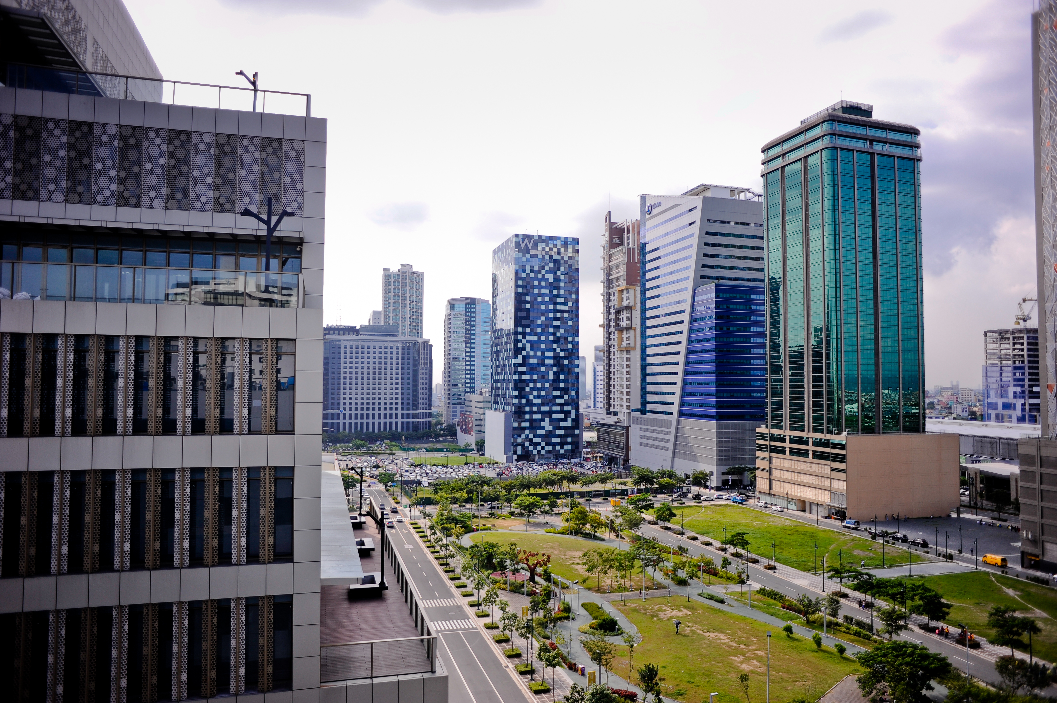
Shared Services Mancom
For the 3rd Quarter
November 7, 2024

Slide 2

AGENDA
TIME | TOPIC | PRESENTER
9:30 am – 9:45 am | Introduction and Discussion of Minutes of the Meeting (Q2) | Cris Dela Cruz
9:45 am – 10:00 am | Human Resources | Juliet Reamillo
10:00 am – 10:15 am | IT | Renz Cabato
10:15 am– 10: 30 am | Business Process/QMSC | Nicole Tumaneng
10:30 am – 10:45 am | Internal Audit | Bea Bernardino
10:45 am – 11:00 am | Question and Answers

Slide 3
Updates from Previous Meeting (July 30, 2024)
 | Issues/Concerns/Updates | Responsibility | Target Date | Status
 | Human Resources
1 | To improve recruitment process by fast track sourcing and making job offer competitive | Juliet | October 2024 | Done
2 | Conduct of Climate Survey | Juliet | Sept 30, 2024 | Done
3 | To create engagement activities for employee retention | Juliet | Nov-Dec ‘24 | Ongoing
4 | To review final pay process | Juliet | Nov 19, 2024 | Ongoing
 | IT
5 | CRMS v2 | Renz | Nov 15, 2024 | Ongoing
6 | Ingredients Inventory Mgt System | Renz | Feb 2025 | Ongoing
Business Process/QMSC
7 | To enhance MDR | Nicole | Nov 4 2024 | Done
8 | To review at least 12 PPGs per month | Nicole | Sept 2024 | Done
Internal Audit
9 | Whistle Blowing through QR Code Policy | Bea | Oct 30 2024 | Done

Slide 4
HUMAN
RESOURCES DEPARTMENT
November 7, 2024

Slide 5

MAJOR ACCOMPLISHMENTS – Q3 2024
ACTIVITIES | ACCOMPLISHMENTS | TIMELINE
Stabilizing the Department | Replacement of Talent Acquisition Assistant | September 2024
 | Onboarded and trained HR Generalist
 | Reviewed performance of Compen&Ben Assistant
Organizational Development | Conducted Organizational Climate Survey | August 2024
 | Leadership Training for Managers in WLI Accounting
Recruitment | Renewed People Dynamics for applicant assessment | September 2024
 | Formulated “Internship policy” to get more candidates

Slide 6
ONGOING PROJECTS FOR Q4
ACTIVITIES | ACCOMPLISHMENTS | TIMELINE
Recruitment | Maximize People Dynamics to filter candidates | November 25, 2024
 | Implement candidate pipeline system to fill roles faster | November 27, 2024
Benefits | Free HMO for Employee Dependents | December 6, 2024
Organizational Development | Revisit 13-point Corporate Engagement Plan - Emergency Response Program - Wellness Programs, APE | December 3, 2024
 | Strengthen Employer Branding | November 22, 2024
Automation of HR Processes | Exit Management Portal | November 26, 2024
 | Recruitment Portal | November 27, 2024

Slide 7

MAJOR ACCOMPLISHMENTS – Q3 2024
ACTIVITIES | ACCOMPLISHMENTS
Organizational Development | Activities: Conducted Organizational Climate Survey Leadership Training for Managers in WLI Accounting Results: 13 point Corporate Engagement Plan Increased understanding of Principles of Management
Recruitment | Activities: Replacement of Talent Acquisition Assistant Onboarded and trained HR Generalist Formulated “Internship policy” Results: 100% of the MRFs served in both WHI and WLI for September 2024 are within turnaround time
Last Pay | Activities: To reduce the total number of processing from 40 working days to 21 working days. Results: Exit Management Portal (November 15) Last Pay policy revision (November 19)
Main Criteria:
-Assessment by PDI
-School
-Experience
-Salary

Slide 8




ONGOING PROJECTS FOR Q4
RECRUITMENT
STATUS: Ongoing
TARGET DATE: Nov. 6, 2024
EMPLOYEE BENEFITS
STATUS: Ongoing
TARGET DATE: Nov. 8, 2024
ATTENDANCE
STATUS: Ongoing
TARGET DATE: Nov. 4, 2024
ORGANIZATIONAL DEVELOPMENT
STATUS: Ongoing
TARGET DATE: Dec. 5, 2024
Problem Statement:
More than 10 delayed MRFs and need for better quality of hires
Objective:
Reduce delayed MRFs to less than five (5)
Improve quality of hires
Activities:
1. Close collaboration with Hiring Managers to ensure quality of candidates
2. Maximize People Dynamics (online assessment) to filter candidates
Problem Statement:
FMD handles documentation which is inconsistent and not streamlined
Objective:
Improved process and clear guidelines
Activities:
1. Revision of policy on loans with BPD
Problem Statement:
Increased number of employees incurring habitual tardiness in a month (target: not more than 3 times in a month)
Objective:
Reduced instances employee tardiness per month
Activities:
1. More timely attendance reporting for close monitoring
2. Consistent and prompt issuance of NTEs and NODs
Problem Statement:
High turn over and low employee morale
Objective:
Reduced attrition rate
Activities:
1. Revisit 13-point Corporate Engagement Plan
Emergency Response Program (Nov. 29)
Wellness Programs, APE (Dec. 2)
2. Strengthen Employer Branding (Nov. 8)

Slide 9
INFORMATIONTECHNOLOGYDEPARTMENT
November 7, 2024

Slide 10
MAJOR ACCOMPLISHMENTS – Q3 2024
AREA | ACTIVITIES | ACCOMPLISHMENTS | TIMELINE
System Development | W Pro - New Modules 201 Records, NOPA History, Guarantors, Reports, Trainings | Percent: 90% Status: Ongoing Validation of IAD | Nov 29, 2024
 | CRMS Re-development Additional Modules | Percent: 80% Status: Ongoing Revisions of new requests. | Parallel live last Sept 4, 2024
Infrastructure | Starlink Installation - New Internet for PBI & Carmona | Savings of PHP 256,720.00/year | Carmona: Oct 5, 2024 PBI: Oct 5, 2024
 | Asset Utilized of new Asset Management System Encoding all Assets | Encode all assets including accessories such as keyboard, mouse. Percent: 85% | Nov 29, 2024

Slide 11
MAJOR ACCOMPLISHMENTS – Q3 2024
ACTIVITIES | ACCOMPLISHMENTS
Starlink Installation | Location: PBI, WHI Carmona Annual Savings: PBI: (PHP 25,000.00 - PHP 2,700.00) * 12 = PHP 267,600 Carmona: (PHP 4,500.00 - PHP 2,700.00) * 12 = PHP 21,600 Total Savings: PHP 289,200 - PHP 32,480 = PHP 256,720/year
Wpro v2 | Monitoring of 201 Records NOPA History Loan Guarantors Reports Trainings
CRMS v1 | Parallel Live: September 4, 2024 Status: Version 1 being used. Ongoing XXXX Ongoing: CRMS v2 (Target Date: November 15, 2024)
Asset Re-count | Count and encode all IT assets, including accessories, into the new Asset Management System. Accomplished on October 11, 2024. Pending: CCC Target Date: November 29, 2024
Completed Timekeeping and Payroll last July 20, 2024
Pending IA Validation of loans and restrictions Target Deadline: November 29, 2024

Slide 12
ONGOING PROJECTS Q4
AREA | ACTIVITIES | TIMELINE
System Development | Recruitment Portal | November 27, 2024
 | Exit Management portal | November 26, 2024
 | CRMS Phase 2 | November 22, 2024
 | W-Smart | December 18, 2024
 | SAP Integration Report | November 29, 2024
Infrastructure | File Storage (Upgrade) | December 20, 2024
 | CCTV – Upgrade Retention Storage | December 20, 2024
 | SAP Upgrade | January 15, 2025
 | Installation of Mikrotik | Febuary 28, 2025

Slide 13
ONGOING PROJECTS FOR Q4
Recruitment Portal
STATUS: For QA
TARGET DATE: Nov 15, 2024
Online Clearance
STATUS: Ongoing
TARGET DATE: Nov 15, 2024
CRMS v2
STATUS: Ongoing
TARGET DATE: Nov 15, 2024
W-Smart
STATUS: Ongoing
TARGET DATE: Nov 30, 2024
Problem Statement:
There are delays in candidate selection, misplaced MRFs, and no data monitoring
Objective:
Simplify hiring process.
Enhances efficiency.
Activities:
Project Charter
Discuss process
QA/User Training
Problem Statement:
Inefficiencies in managing and processing clearances due to manual process, confusion in requirements and not data monitoring
Objective:
3 days cleared after last day.
Centralized Monitoring for clearances and history.
No physical routing.
Activities:
Project Charter
Process Discussion
Objective:
Redesign to include Phase 2, allowing for easy adjustments based on proponent feedback. This ensures ongoing improvements throughout the project.
Activities:
Project Charter
Process Discussion
Problem Statement:
Additional Cost for Users and Modules
Limited Users.
Objective:
Unlimited Users.
Easily adjustment.
Reports.
Activities:
Project Charter
Procurement Module
Inventory Module
Tenant Management

Slide 14
BUSINESS PROCESS DEPARTMENT
November 7, 2024

Slide 15
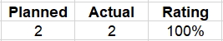
MAJOR ACCOMPLISHMENTS – Q3 2024
AREA | ACTIVITIES | ACCOMPLISHMENTS | TIMELINE
PROCESS IMPROVEMENT | PPG Review Conduct sixteen (16) process review monthly Revised PPGs based on the sixteen (16) process review | 48/48 = 100% 6/48 = 12.5% (Ongoing revision) | Q3 Q3 – Q4
AUDIT ACTIVITIES | Management System Internal Audit Conduct monthly audit to WGI and its affiliates based on the audit programme | Department: PBI and MRDC | Q3

Slide 16
MAJOR ACCOMPLISHMENTS – Q3 2024
AREA | ACTIVITIES | ACCOMPLISHMENTS | TIMELINE
PERFORMANCE EVALUATION | MDR KPI Enhancement Revision of KPI Criteria of the following departments: a. ITD b. HRD c. FMD d. WLI Procurement
Notes:
-The changes in WLI Procurement's KPIs indicate an 8% improvement compared to Quarter 2 rating
-The changes in Human Resources Department KPIs indicate 29% improvement compared to Quarter 2 rating
-The Changes in Facilities Management Office / Admin KPIs indicate 16% improvement compared to Quarter 2 rating

Slide 17
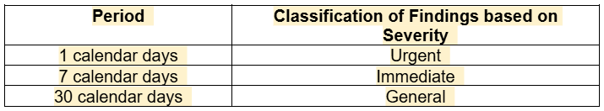
MAJOR ACCOMPLISHMENTS – Q3 2024
ACTIVITIES | ACCOMPLISHMENTS
APPROVED MDR POLICY | 1. Removal of Business Plan since majority are not implemented and further deductions were given for delays Performance Failure Rate reduce from 50% to 12%
INTERNAL QUALITY AUDITS | Revision of the Internal Quality Audit to improve target completion date for closing CARs, which will be determined based on the severity of the findings and the implementation of corrective actions. The status of CARs shall be monitored and reported to all Department Heads on a monthly basis.
KPI ENHANCEMENT | Enhanced MDR KPI for: ITD, HRD, FMD, OTC LEASING, R&D, WLI PROCUREMENT
PPG REVIEW | PPG REVIEW KICK-OFF – AUGUST 2024 Reviewed 24 PPGs from August to September 2024 Approved 14 PPGs from July to September (New and Revised)

Slide 18
ONGOING PROJECTS FOR Q4
AREA | ACTIVITIES | TIMELINE
STATUTORY AND REGULATORY COMPLIANCE | FSSC 22000 Version 6 Internal Training (Online) Ensures that the employees effectively implements and maintains the food safety management system (FSMS) in compliance with the certification requirements. | November 2024
PROCESS IMPROVEMENT | Innovation Policy Establishment of innovation guidelines and its critera. | November 2024

Slide 19
ONGOING PROJECTS FOR Q4
AREA | ACTIVITIES | TIMELINE
PROCESS AUTOMATION | W - SMART An inhouse automated system for purchasing process integrated to Netsuite with unlimited number of users. This will have a cost reduction of Php 584,292.00 per year. | November 29, 2024
 | Audit Portal To digitize the audit and corrective action reporting process to reduce the approval time and closure time for corrective actions. | December 2024

Slide 20
ONGOING PROJECTS FOR Q4
FSSC Ver. 6
Internal Training
STATUS: Ongoing
TARGET DATE: November 2024
Innovation
Policy
STATUS: Ongoing
TARGET DATE: November 2024
W-SMART
STATUS: Ongoing
TARGET DATE: Nov 29 2024
SWOT
Analysis
STATUS: Ongoing
TARGET DATE: Dec 2024
Problem Statement:
New hires are unequipped with general policies, procedures and guidelines.
Objective:
Refresher Training for WHI Employees
Activities:
Online Training
Problem Statement:
Departments do not have proposed innovation or clear idea on how to proposed an innovation.
Objective:
Enhanced Criteria
Guideline Creation
Activities:
Executive Summary
Draft Policy
Approval
Cascade
Problem Statement:
Additional cost of Php 2.5 M for reconfiguration of NetSuite from ITG based on the recent system review.
Objective:
Reduce license and module cost (PHP 584,292.00 per year)
Activities:
Project Charter Approval
Scoping
System Development
Implementation
Problem Statement:
No proper methodology on how to conduct risk assessment. Thus SWOT Analysis provides comprehensive overview that supports strategic decision-making, helps set goals, guides resource allocation to minimize weaknesses and mitigate possible threats.
Objective:
Identify Risk per process.
To train employees on proper Risk Assessment
Activities:
SWOT Analysis Training
Risk Assessment

Slide 21
INTERNAL AUDIT DEPARTMENT
October 31, 2024

Slide 22
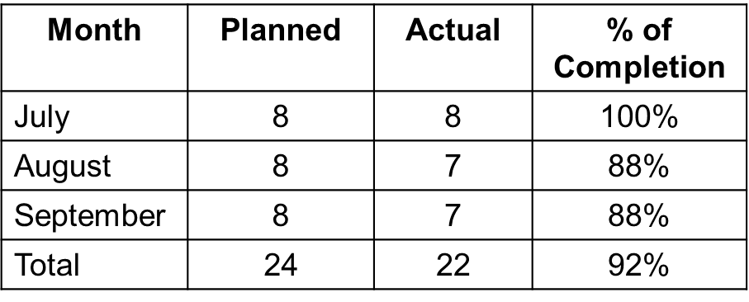
MAJOR ACCOMPLISHMENTS – Q3 2024
ACTIVITIES | ACCOMPLISHMENTS | TIMELINE
Audit Engagement | Percentage of completed audit engagements for Q3: Audit Highlights: Audit of Treasury (WLI and WHI) Issue: Idle funds were not properly monitored and invested. Result: Additional income from Php 7.9M to 13M (August – October 2024) | 09/30/2024

Slide 23
MAJOR ACCOMPLISHMENTS – Q3 2024
ACTIVITIES | ACCOMPLISHMENTS | TIMELINE
Audit Engagement | 2. Audit of Income Collection (HLPI/THI/WFA/WOI) Issue: Recommendation: Strict enforcement of the issuance of post-dated cheques upon signing of the lease agreement. 3. Audit of Procurement Process Issue: lack of manpower resulting to pending orders. Result: Reduced “pending orders” from 32 last July 25, 2024 to 10 PRs as of October 30, 2024. Transferred the canvassing procedure from PRI Team to PRD. | 10/30/2024

Slide 24
MAJOR ACCOMPLISHMENTS – Q3 2024
ACTIVITIES | ACCOMPLISHMENTS | TIMELINE
Audit Engagement | 4. Audit of CCC Plant Production and Operations Issue: Inaccurate SW Yield Report Recommendations: Strengthen the review process on the Daily Production Report (DPR). Process improvements on the following: Implementing MIS for Chemicals Printing of weight slip per SW lot code and after the sieving process | 11/30/2024

Slide 25
MAJOR ACCOMPLISHMENTS – Q3 2024
ACTIVITIES | ACCOMPLISHMENTS | TIMELINE
Audit Engagement | 5. Audit of Carmona Plant Inventory Management Issue: Late recording in SAP Results: Established procedures for the advance turn-in of coarse powder Upgrade of internet connection Improved timeliness of recording by adding SAP access | 09/30/2024

Slide 26
MAJOR ACCOMPLISHMENTS – Q3 2024
ACTIVITIES | ACCOMPLISHMENTS | TIMELINE
Other Tasks | Audit of 2023 Management Fees Result: Established guidelines for the processing of dividens and management fees. Lazada/ Shopee Purchases Result: Established procedures for the processing of online purchases. Petty Cash Fund Result: Revised guidelines for the authorized expenses chargeable to PCF. Netsolar Project Result: Established guidelines for CAPEX. | 09/30/2024

Slide 27
ONGOING PROJECTS– Q4 2024
AREA | PROJECT | BENEFITS | TIMELINE
COMPLIANCE | Whistleblowing thru QR Code | Concerned employee/s have an additional platform for reporting issues anonymously. | 11/30/2024
 | Revisions of IA PPG | Updated policies and compliance with AMLC findings | Q1 of 2025

Slide 28
MAJOR ACCOMPLISHMENTS – Q3 2024 (FOOD INGREDIENTS)
ACTIVITIES | ACCOMPLISHMENTS / RECOMMENDATIONS
1. Audit of CCC Plant Production and Operations Major Issue: Inaccurate SW Yield Report Date Audited: July 2024 | Strengthen the review process on the Daily Production Report (DPR) Process improvements on the Seaweeds, Chemicals and Factory Supplies withdrawal process by: Implementing Material Issuance Slip for Chemicals Printing of weight slip per SW lot code Issuance of memo for factory supplies withdrawals during night shift Printing of weight slip after the sieving process To agree on specific documents to present for closure
2. Audit of Inventory Management Major Issue: Late recording in SAP due to limited SAP access Date Audited : August 2024 | Established procedures for the following: Advance turn-in of coarse powder (Theoretical computation and reconciliation) Mazaraga items delivered to Carmona Plant. Upgrade of internet connection in Carmona Plant (Starlink) Improved timeliness of recording by adding SAP access

Slide 29
MAJOR ACCOMPLISHMENTS – Q3 2024 (FOOD INGREDIENTS)
ACTIVITIES | ACCOMPLISHMENTS / RECOMMENDATIONS
3. Audit of HR Benefits Report Major Issues: Inconsistencies of data and Incomplete Filings of documents Audit Date: September 2024 | Established employees’ company loan balances Established procedures for special cases like delayed delivery of vehicles and treatment of input vat Transferred processing of EMP/ECP from FMD to HRD

Slide 30
MAJOR ACCOMPLISHMENTS – Q3 2024 (REAL ESTATE)
ACTIVITIES | ACCOMPLISHMENTS / RECOMMENDATIONS
1. Audit of Income Collection (HLPI, THI, WFA and WOI) | Strictly enforce the issuance of post-dated cheques upon signing of lease agreement
Audit of Treasury Major Issue: Idle Funds | Idle funds were not properly monitored and invested This resulted to additional income from Php 7.9M to 13M (August to October 2024)

Slide 31
MAJOR ACCOMPLISHMENTS – Q3 2024 (REAL ESTATE)
ACTIVITIES | ACCOMPLISHMENTS / RECOMMENDATIONS
3. Audit of Procurement Process Major Issues: Irregular Payment Terms and Delayed Processing of PR to PO | People issues resulting to pending orders Reduced “pending orders” from 32 last July 25, 2024 to 10 PRs as of October 30, 2024 Proposed process improvements for the following: Transferred the canvassing procedure from PRI team to PRD Vendor Accreditation – Vendor name should be based on the legal documents (BIR 2303) provided by the supplier Change in payment terms is not allowed unless re-approved by the HBU

Slide 32
ONGOING PROJECTS FOR Q4
WHISTLEBLOWING THRU QR CODE
STATUS: Ongoing
TARGET DATE: Nov. 15, 2024
REVISIONS OF
IA PPG
STATUS: Ongoing
TARGET DATE: Dec. 31, 2024
Problem Statement:
Employees have limited options for reporting issues anonymously.
Objective:
Concerned employee/s may report issues anonymously.
Activities:
Project Charter Approval
Documented policies and procedures
Development of QR code
Orientation
Problem Statement:
Outdated IA PPGs.
Objective:
To update the policies and procedures based on the current set-up (Audit Portal) and AMLC findings.
Activities:
Executive Summary
Documented policies and procedures

Slide 33
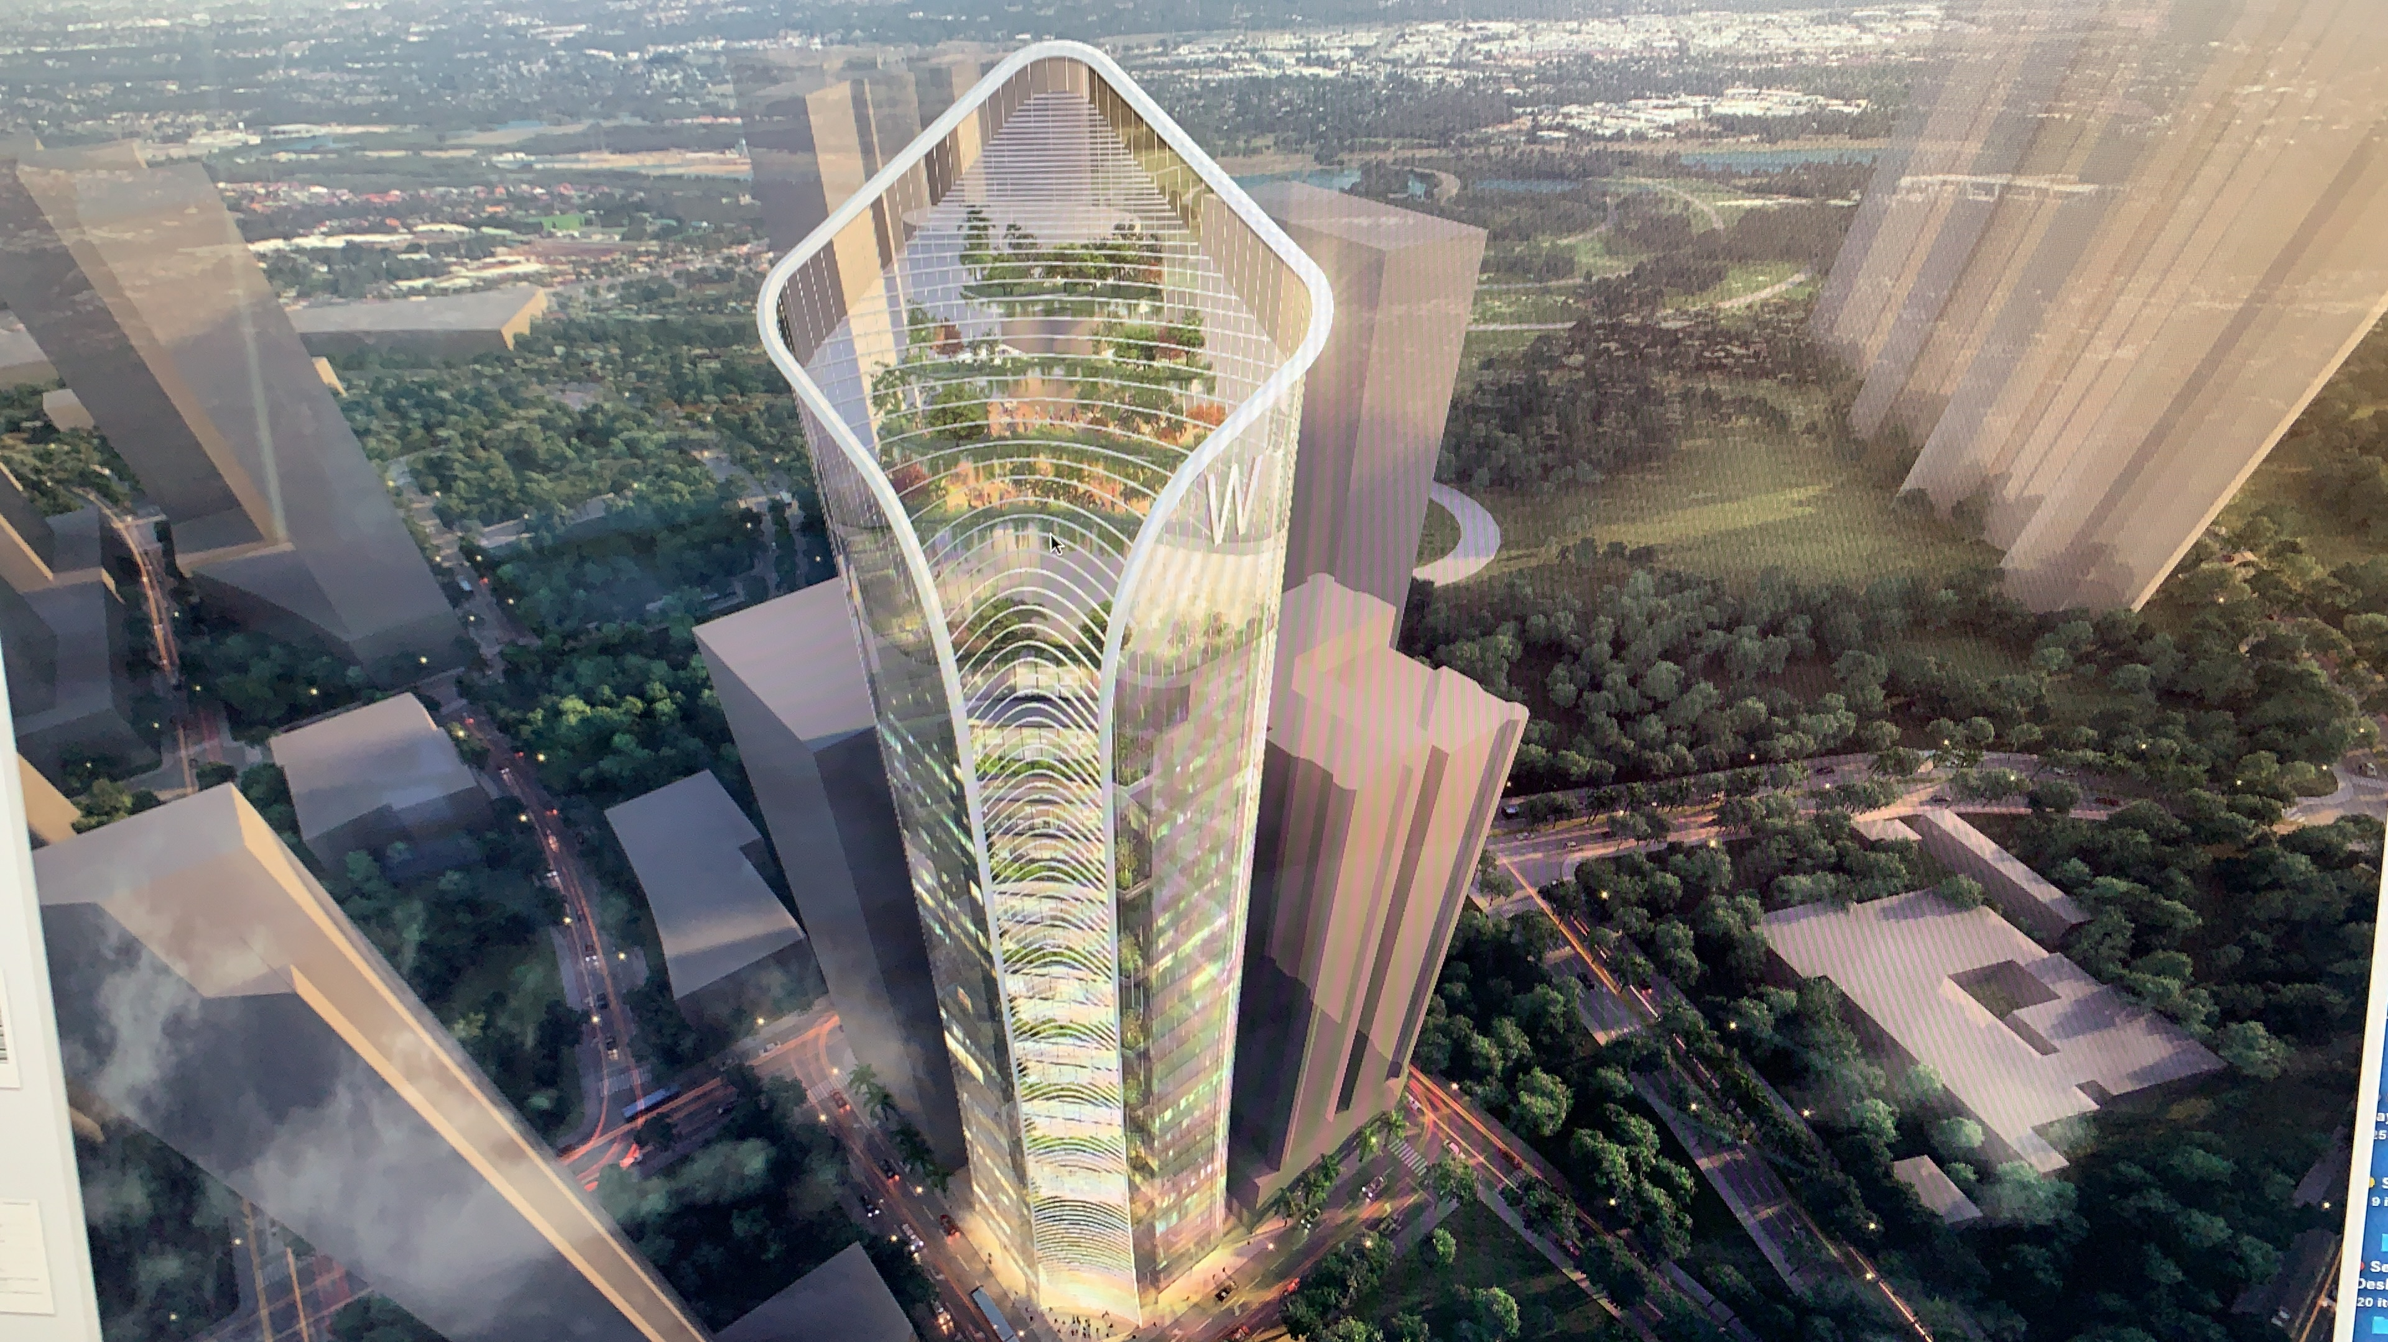
Thank you!

